Slide 1
DSA 210 PROJECT
My Netflix Viewing Habits
Sena Toker

Slide 2
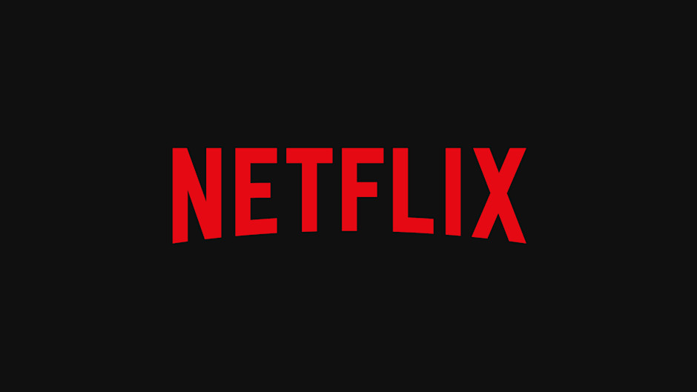
Motıvatıon and aım
As someone who spends a considerable amount of time on both Netflix and Instagram, in this project, I want to better understand my viewing habits and preferences. This projects aims to analyze my Netflix data to uncover patterns such as:
Which genres capture my attention the most?
Is there a correlation between my watching habits and IMDb ratings?
Are there specific behaviors (for example binge-watching) associated with certain genres?
Is there a correlation the between days of the week and my watching habits?

Slide 3
Hypothesıs 1:
H0: There is no correlaton between IMDb ratings and my viewing habits.
H1: There is a correlation between IMDb ratings and my viewing habits.
In order to test this hypothesis, I deepened the data I got from Netflix website, using IMDb metadata and I extracted the genres from this dataset.
After cleaning and organizing, the dataset was ready to perform tests on it.

Slide 4
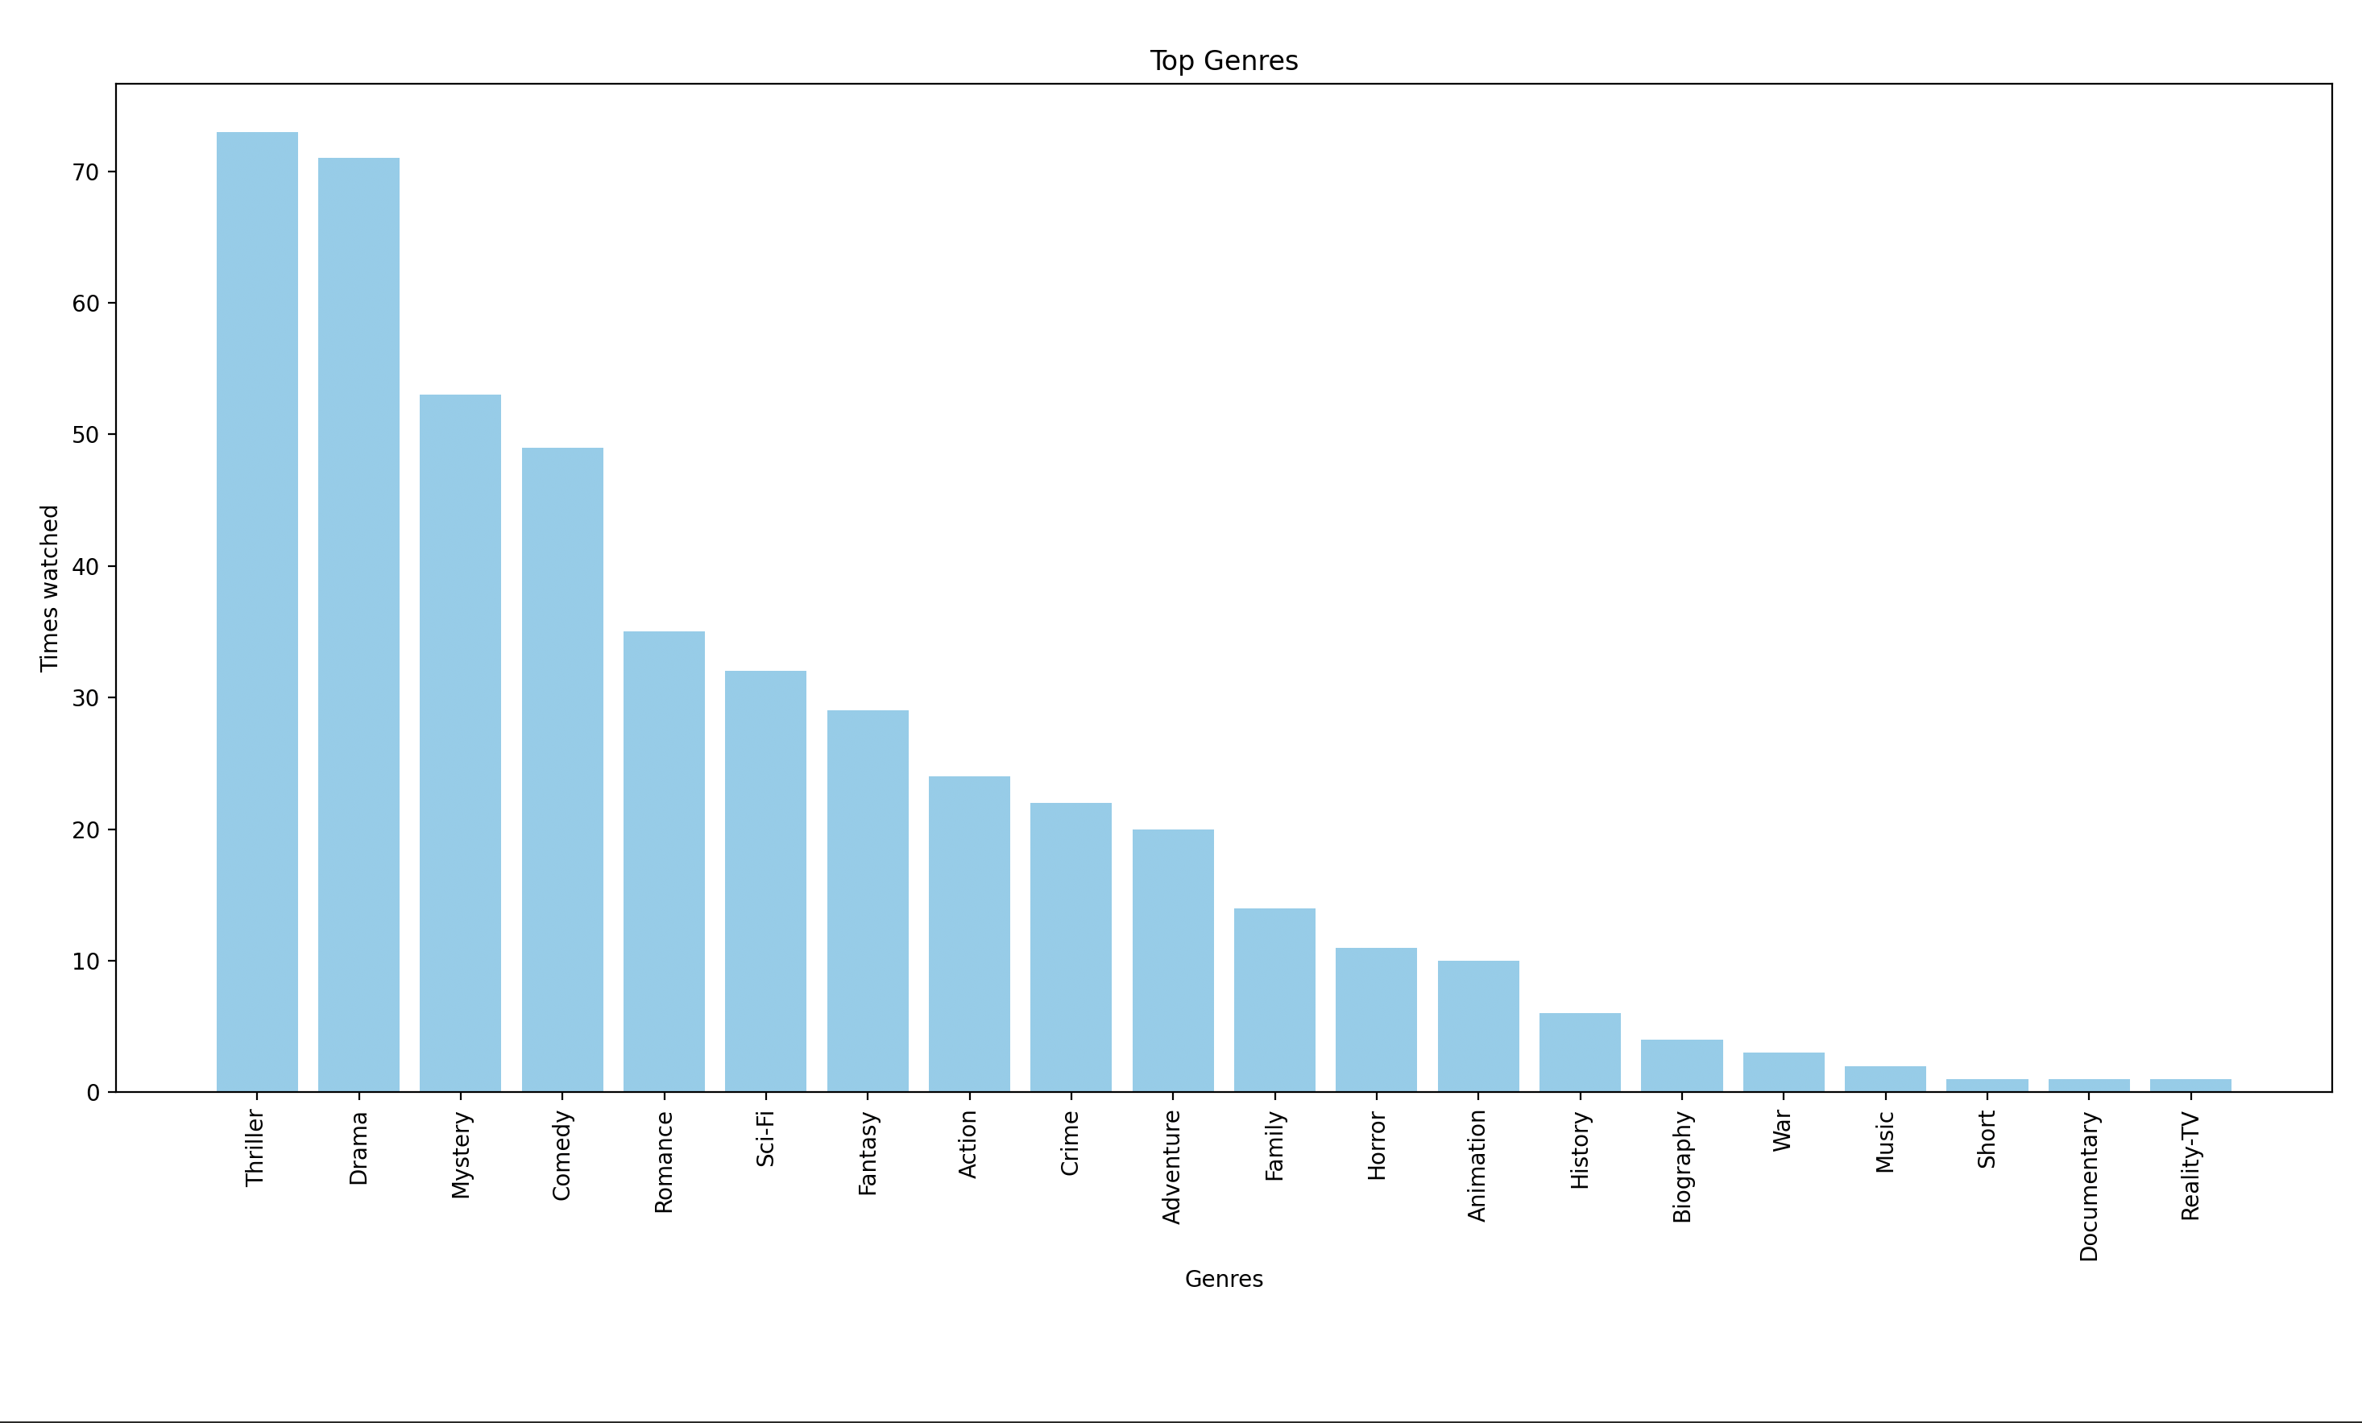
Watchıng habits/genre CHART
First, I created this bar chart to explore the distribution of my viewing habits by genre.

Slide 5
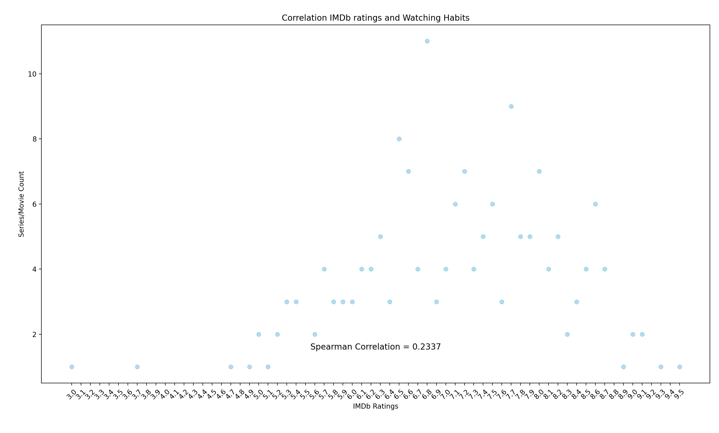
IMDb RATINGS/WATCHING HABITS CHART
With this scatter chart and calculated Spearmen correlation, we test the null hypothesis and decided not to reject it.

Slide 6
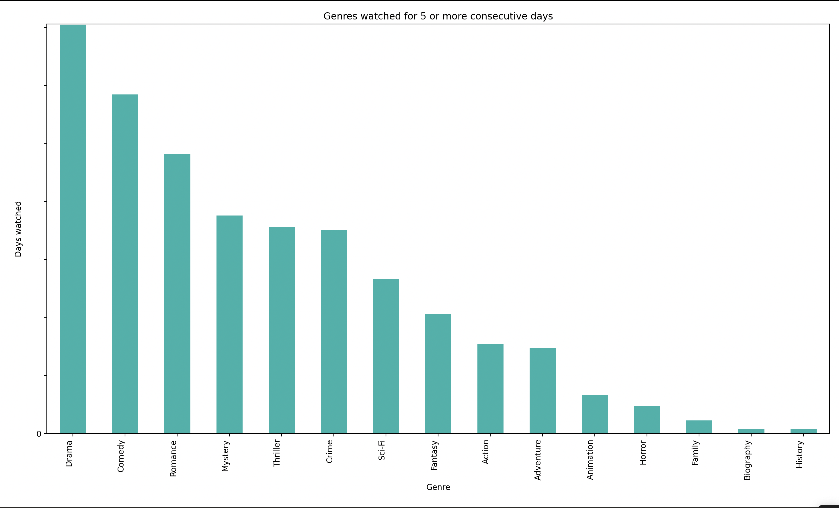
Binge Watchıng/genre Chart
With this scatter chart, I analyzed my binge watching habits in order to see which genres attract my attention the most

Slide 7
Hypothesıs 1I
H0: There is no correlation between the days of the week and my watching habits.
H1: There is a correlation between the days of the week and my watching habits.
In order to test this hypothesis, I used my Netflix data, and I analyzed it to see if the days of the week and my Netflix watching habits are dependent by calculating the p-value.

Slide 8
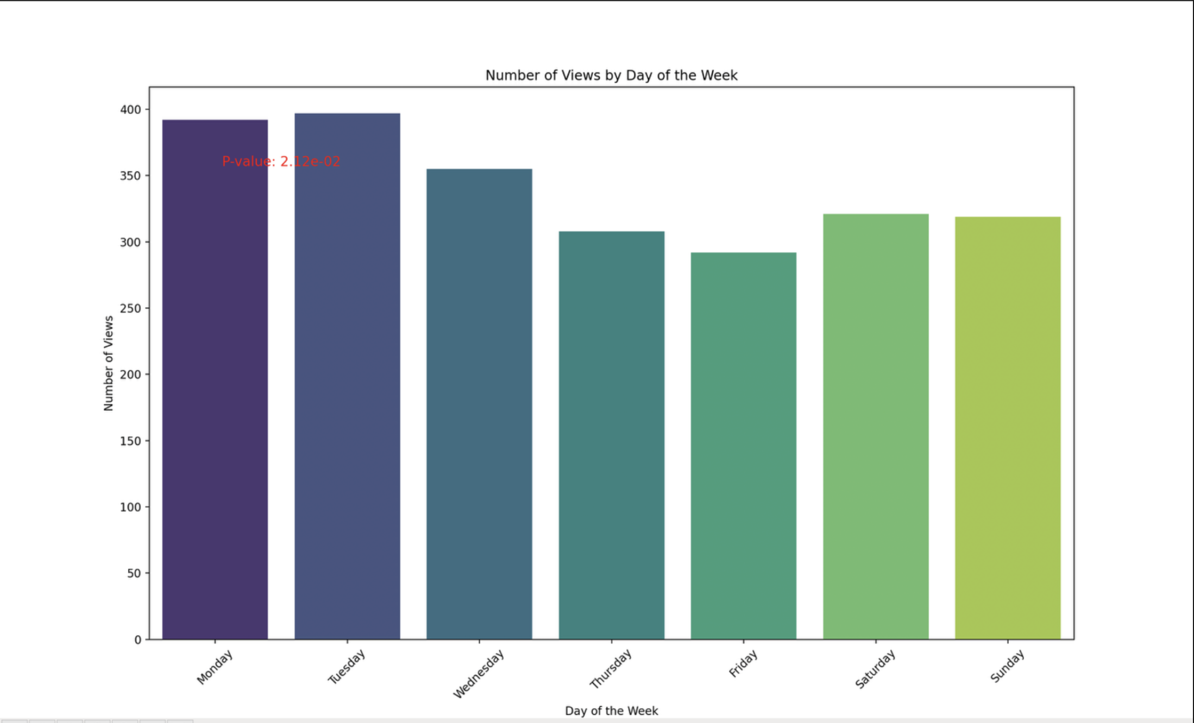
Days of the week/watching habıts chart
I calculated the p-value as 0.02 which is less than the signifance level. This test showed that the days and my Netflix habits are dependent and I can reject the null hypothesis.

Slide 9
CONCLUSIONS
My watching habits and IMDb rating are independent to each other.
My watching habits and the days of the weeks are dependent to each other.

